Slide 1
Digital Twin Software Architecture
With Aftermarket Software Integration

Slide 2
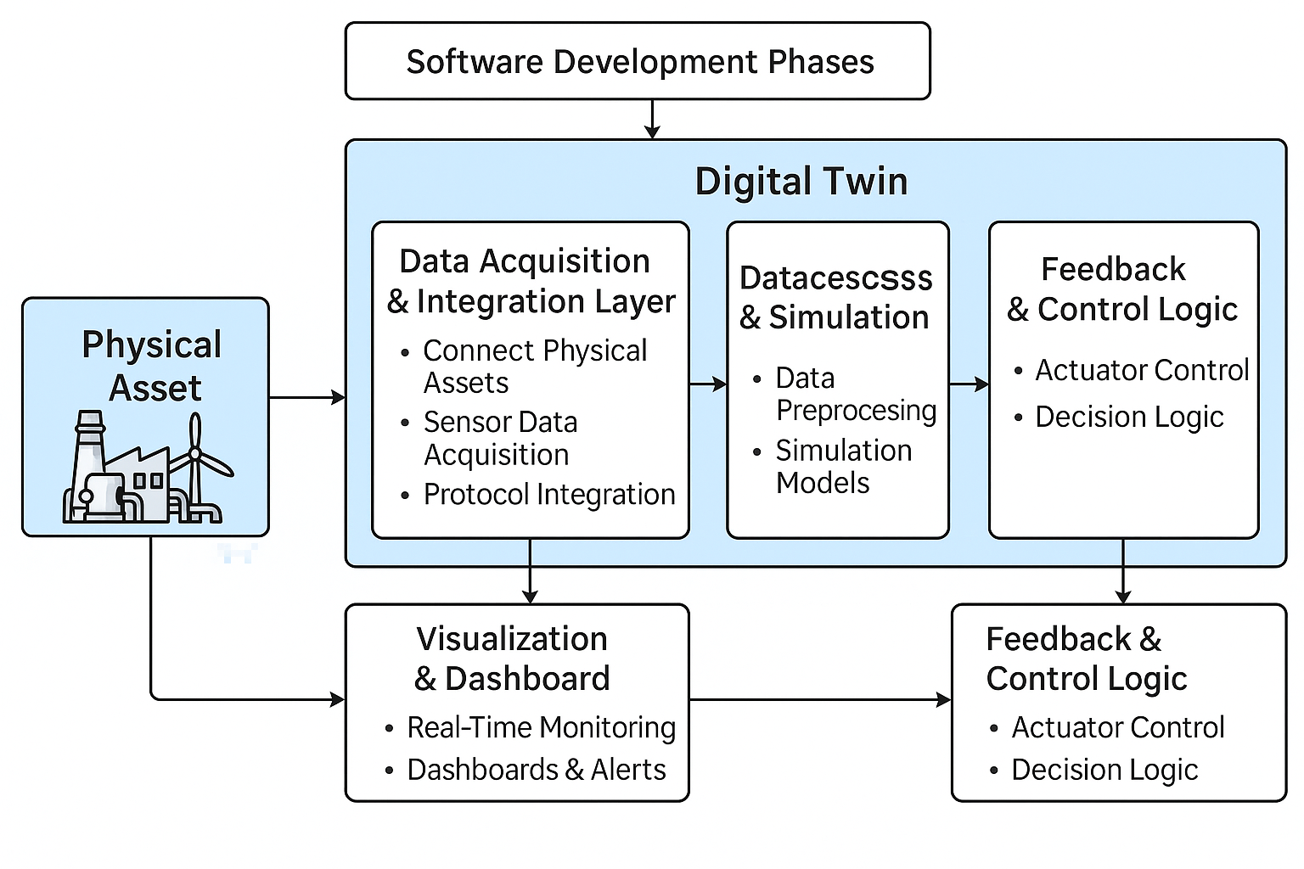
Overview Architecture Diagram

Slide 3
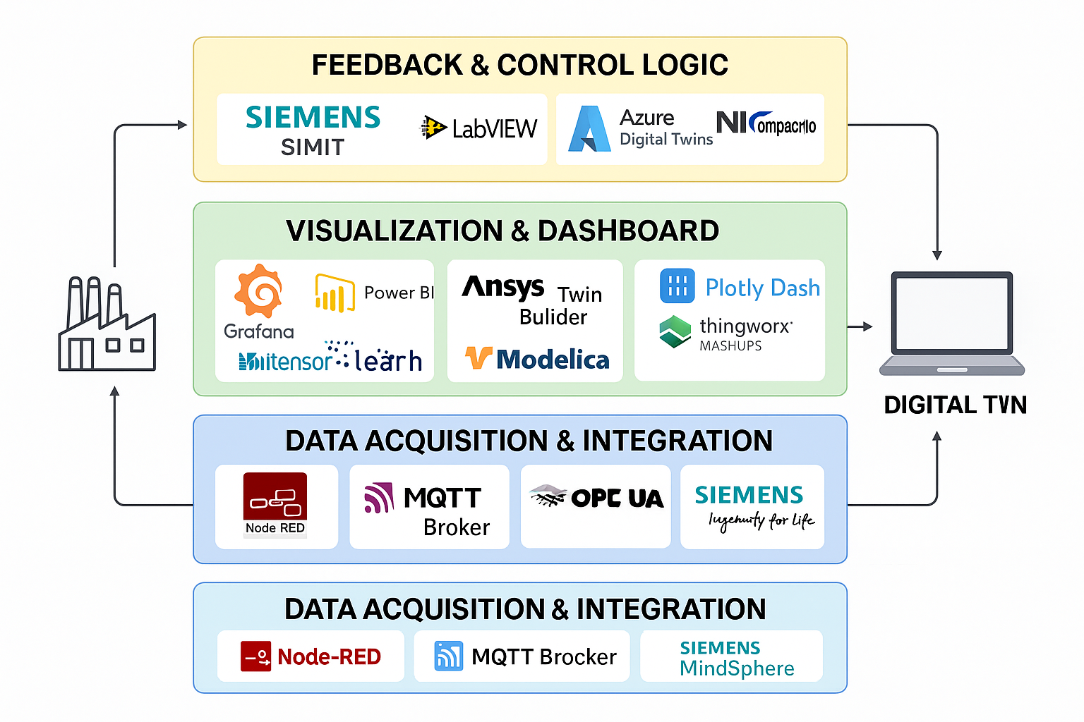
Architecture with Aftermarket Software Tools

Slide 4
Aftermarket Tool Mapping by Architecture Layer
1. Data Acquisition & Integration:
- Node-RED
- MQTT Broker (e.g., Mosquitto)
- OPC UA Servers
- Siemens MindSphere
2. Data Processing & Simulation:
- MATLAB/Simulink
- ANSYS Twin Builder
- Modelica (OpenModelica, Dymola)
- TensorFlow / scikit-learn
4. Feedback & Control Logic:
- Siemens SIMIT
- LabVIEW
- Azure Digital Twins API
- NI CompactRIO
3. Visualization & Dashboard:
- Grafana
- Power BI
- Plotly Dash
- ThingWorx Mashups

Slide 5
Aftermarket Tool Mapping by Architecture Layer
1. Data Acquisition & Integration: - Node-RED - MQTT Broker (e.g., Mosquitto) - OPC UA Servers - Siemens MindSphere | 3. Visualization & Dashboard: - Grafana - Power BI - Plotly Dash - ThingWorx Mashups
2. Data Processing & Simulation: - MATLAB/Simulink - ANSYS Twin Builder - Modelica (OpenModelica, Dymola) - TensorFlow / scikit-learn | 4. Feedback & Control Logic: - Siemens SIMIT - LabVIEW - Azure Digital Twins API - NI CompactRIO

